Slide 1
Topological Sort

Slide 2
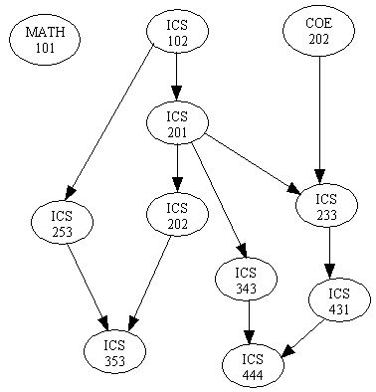
Introduction
There are many problems involving a set of tasks in which some of the tasks must be done before others.
For example, consider the problem of taking a course only after taking its prerequisites.
Is there any systematic way of linearly arranging the courses in the order that they should be taken?
Yes! - Topological sort.

Slide 3
Directed Acyclic Graphs
A directed acyclic graph or DAG is a directed graph with no directed cycles:

Slide 4
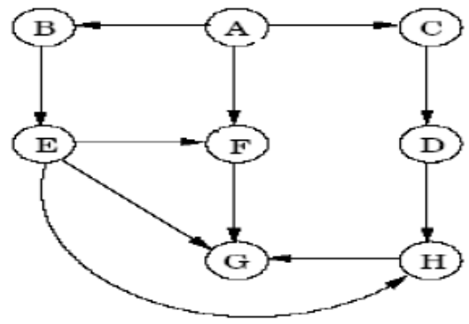
DAG Properties
A directed acyclic graph (DAG) is a directed graph without cycles.
DAGs arrise in modeling many problems that involve prerequisite constraints (construction projects, course prerequisites, document version control, compilers, etc.)
Some properties of DAGs:
  Every DAG must have at least one vertex with in-degree zero and at least one vertex with out-degree zero
    A vertex with in-degree zero is called a source vertex, a vertex with out-degree zero is called a sink vertex.
  Every edge (v, w) in a DAG G has finishingTime[w] < finishingTime[v] in a DFS traversal of G
Example:

Slide 5
Topological Sort
Let S be a directed graph without cycles(or a partial order set). A topological sort T of S is a linear ordering of the nodes of S which preserves the original partial ordering of S. That is: If u<v in S(i.e ,if there is a path from u to v in S), then u comes before v in the linear ordering of T.

Slide 6
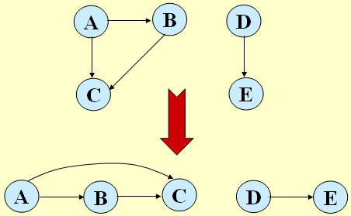
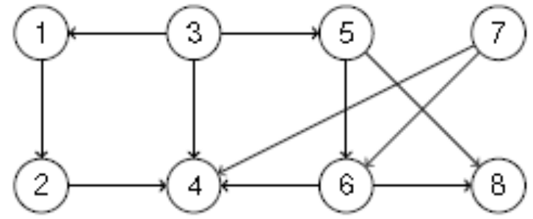
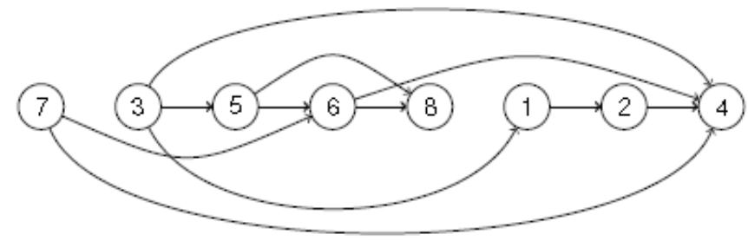
Definition of Topological Sort
Given a directed graph G = (V, E) a topological sort of G is an
ordering of V such that for any edge (u, v), u comes before v in
the ordering.
Example1:
Example2:

Slide 7
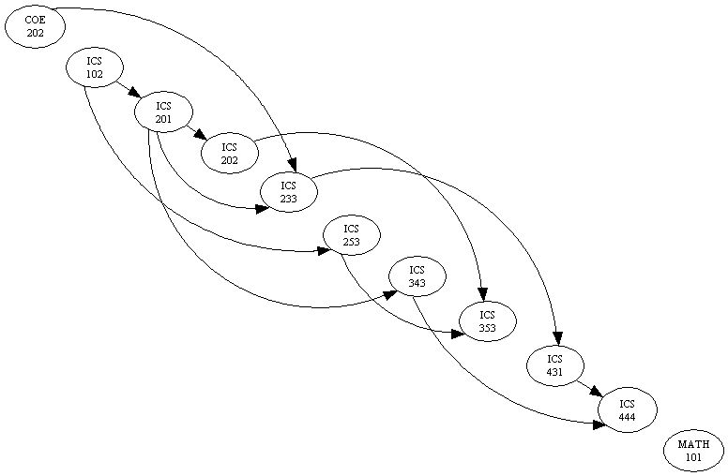
Definition of Topological Sort
Example3: The graph in (a) can be topologically sorted as in (b)
(a)
(b)

Slide 8
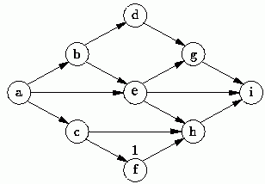
Topological Sort is not unique
Topological sort is not unique.
The following are all topological sort of the graph below:
s1 = {a, b, c, d, e, f, g, h, i}
s2 = {a, c, b, f, e, d, h, g, i}
s3 = {a, b, d, c, e, g, f, h, i}
s4 = {a, c, f, b, e, h, d, g, i}
etc.

Slide 9
Topological Sort(Method-I)
Performed on a DAG.
Linear ordering of the vertices of G such that if (u, v) ∈ E, then u appears somewhere before v.
Topological-Sort (G)
call DFS(G) to compute finishing times f [v] for all v ∈ V
as each vertex is finished, insert it onto the front of a linked list
return the linked list of vertices
Time: Θ(V + E).

Slide 10
Example
A
B
D
1/
C
E
Linked List:

Slide 11
Example
A
B
D
1/
2/
C
E
Linked List:

Slide 12
Example
A
B
D
1/
2/3
C
E
Linked List:
2/3
E

Slide 13
Example
A
B
D
1/4
2/3
C
E
Linked List:
1/4
2/3
D
E

Slide 14
Example
A
B
D
5/
1/4
2/3
C
E
Linked List:
1/4
2/3
D
E

Slide 15
Example
A
B
D
5/
1/4
6/
2/3
C
E
Linked List:
1/4
2/3
D
E

Slide 16
Example
A
B
D
5/
1/4
6/7
2/3
C
E
Linked List:
6/7
1/4
2/3
C
D
E

Slide 17
Example
A
B
D
5/8
1/4
6/7
2/3
C
E
Linked List:
5/8
6/7
1/4
2/3
B
C
D
E

Slide 18
Example
A
B
D
9/
5/8
1/4
6/7
2/3
C
E
Linked List:
5/8
6/7
1/4
2/3
B
C
D
E

Slide 19
Example
A
B
D
9/10
5/8
1/4
6/7
2/3
C
E
Linked List:
9/10
5/8
6/7
1/4
2/3
A
B
C
D
E

Slide 20
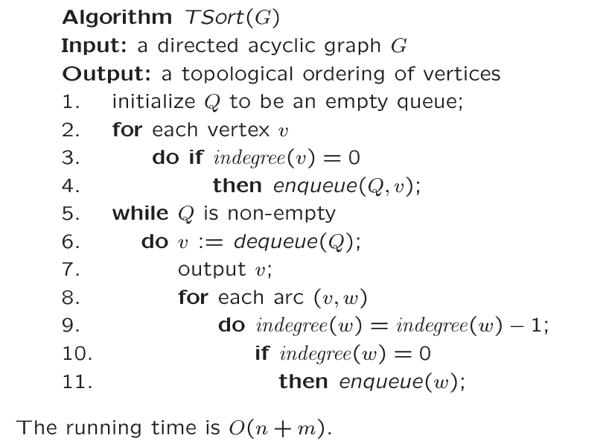
Topological Sort – Using Queue(Method-II)
Store all the tasks
which can be selected.
Find all tasks that can be selected.
Reduce indegree(w) by 1
Place w to Q
if indegree(w)=0

Slide 21
Example
Indegree
0
1
2
3
4
5
6
7
8
9
6 | 1 | 4
0
1
2
3
4
5
6
7
8
9
0
1
2
1
1
2
1
1
2
2
2
6
3
7 | 5
8
8
5
0
2
7
9
1
9
3 | 2
5
8
4
9
Q = { 0 }

Slide 22
Example
Indegree
0
1
2
3
4
5
6
7
8
9
6 | 1 | 4
0
1
2
3
4
5
6
7
8
9
0
1
2
1
1
2
1
1
2
2
2
-1
6
3
7 | 5
8
8
-1
5
0
2
7
9
1
9
-1
3 | 2
5
8
4
9
Dequeue 0 → Q = { }
→ remove 0’s arcs – adjust
indegree of neighbors
Decrement 0’s
neighbors
OUTPUT: 0

Slide 23
Example
Indegree
0
1
2
3
4
5
6
7
8
9
6 | 1 | 4
0
1
2
3
4
5
6
7
8
9
0
0
2
1
0
2
0
1
2
2
2
6
3
7 | 5
8
8
5
0
2
7
9
1
9
3 | 2
5
8
4
9
Dequeue 0→ Q={ } → Q = { 6, 1, 4 }
OUTPUT: 0

Slide 24
Example
Indegree
0
1
2
3
4
5
6
7
8
9
6 | 1 | 4
0
1
2
3
4
5
6
7
8
9
0
0
2
1
0
2
0
1
2
2
2
6
3
7 | 5
-1
8
-1
8
5
0
2
7
9
1
9
3 | 2
5
8
4
9
Dequeue 6 → Q = { 1, 4 }
Remove arcs .. Adjust indegree
of 6’s neighbors
Adjust neighbors
indegree
OUTPUT: 0 6

Slide 25
Example
Indegree
0
1
2
3
4
5
6
7
8
9
6 | 1 | 4
0
1
2
3
4
5
6
7
8
9
0
0
1
0
0
2
0
1
2
2
2
6
3
7 | 5
8
8
5
0
2
7
9
1
9
3 | 2
5
8
4
9
Dequeue 6 → Q={1, 4} → Q = { 1, 4, 3 }
OUTPUT: 0 6

Slide 26
Example
Indegree
0
1
2
3
4
5
6
7
8
9
6 | 1 | 4
0
1
2
3
4
5
6
7
8
9
0
0
1
0
0
2
0
1
2
2
2
-1
6
3
7 | 5
8
8
5
0
2
7
9
1
9
3 | 2
5
8
4
9
Dequeue 1 → Q = { 4, 3 }
Adjust neighbors
OUTPUT: 0 6 1

Slide 27
Example
Indegree
0
1
2
3
4
5
6
7
8
9
6 | 1 | 4
0
1
2
3
4
5
6
7
8
9
0
0
0
0
0
2
0
1
2
2
2
6
3
7 | 5
8
8
5
0
2
7
9
1
9
3 | 2
5
8
4
9
Dequeue 1 → Q={4, 3} → Q = { 4, 3, 2 }
OUTPUT: 0 6 1

Slide 28
Example
Indegree
0
1
2
3
4
5
6
7
8
9
6 | 1 | 4
0
1
2
3
4
5
6
7
8
9
0
0
0
0
0
2
0
1
2
2
2
6
3
7 | 5
8
8
5
0
2
7
9
-1
1
9
3 | 2
5
8
4
9
Dequeue 4 → Q = { 3, 2 }
Adjust neighbors indegree
OUTPUT: 0 6 1 4

Slide 29
Example
Indegree
0
1
2
3
4
5
6
7
8
9
6 | 1 | 4
0
1
2
3
4
5
6
7
8
9
0
0
0
0
0
1
0
1
2
2
2
6
3
7 | 5
8
8
5
0
2
7
9
1
9
3 | 2
5
8
-1
4
9
Dequeue 3 → Q = { 2 }
Adjust 3’s neighbors
OUTPUT: 0 6 1 4 3

Slide 30
Example
Indegree
0
1
2
3
4
5
6
7
8
9
6 | 1 | 4
0
1
2
3
4
5
6
7
8
9
0
0
0
0
0
1
0
1
1
2
2
6
3
7 | 5
8
8
5
0
2
7
9
-1
1
9
3 | 2
-1
5
8
4
9
Dequeue 2 Q = { }
Adjust 2’s neighbors
OUTPUT: 0 6 1 4 3 2

Slide 31
Example
Indegree
6 | 1 | 4
0
1
2
3
4
5
6
7
8
9
0
0
0
0
0
0
0
0
1
2
0
1
2
3
4
5
6
7
8
9
2
6
3
7 | 5
8
8
5
0
2
7
9
1
9
3 | 2
5
8
4
9
Dequeue 2 → Q= { } →Q = { 7, 5 }
OUTPUT: 0 6 1 4 3 2

Slide 32
Example
Indegree
0
1
2
3
4
5
6
7
8
9
6 | 1 | 4
0
1
2
3
4
5
6
7
8
9
0
0
0
0
0
0
0
0
1
2
2
6
3
7 | 5
8
8
5
0
2
7
9
1
9
3 | 2
5
8
4
9
-1
Dequeue 7 → Q = { 5 }
Adjust neighbors
OUTPUT: 0 6 1 4 3 2 7

Slide 33
Example
Indegree
0
1
2
3
4
5
6
7
8
9
0
0
0
0
0
0
0
0
0
2
0
1
2
3
4
5
6
7
8
9
6 | 1 | 4
2
6
3
7 | 5
8
8
5
0
2
7
9
1
9
3 | 2
5
8
4
9
Dequeue 7→ Q = { 5 } → Q= { 5, 8}
OUTPUT: 0 6 1 4 3 2 7

Slide 34
Example
Indegree
0
1
2
3
4
5
6
7
8
9
6 | 1 | 4
0
1
2
3
4
5
6
7
8
9
0
0
0
0
0
0
0
0
0
2
2
6
3
7 | 5
8
8
5
0
2
7
9
1
9
3 | 2
5
8
4
9
-1
Dequeue 5 → Q = { 8 }
OUTPUT: 0 6 1 4 3 2 7 5

Slide 35
Example
Indegree
0
1
2
3
4
5
6
7
8
9
6 | 1 | 4
0
1
2
3
4
5
6
7
8
9
0
0
0
0
0
0
0
0
0
1
2
6
3
7 | 5
8
8
5
0
2
7
9
1
9
3 | 2
5
8
4
9
-1
Dequeue 8 → Q = { }
OUTPUT: 0 6 1 4 3 2 7 5 8

Slide 36
Example
Indegree
0
1
2
3
4
5
6
7
8
9
6 | 1 | 4
0
1
2
3
4
5
6
7
8
9
0
0
0
0
0
0
0
0
0
0
2
6
3
7 | 5
8
8
5
0
2
7
9
1
9
3 | 2
5
8
4
9
Dequeue 8 → Q = { } → Q = { 9 }
OUTPUT: 0 6 1 4 3 2 7 5 8

Slide 37
Example
Indegree
0
1
2
3
4
5
6
7
8
9
6 | 1 | 4
0
1
2
3
4
5
6
7
8
9
0
0
0
0
0
0
0
0
0
0
2
6
3
7 | 5
8
8
5
0
2
7
9
1
9
3 | 2
5
8
4
9
Dequeue 9 → Q = { } → Done
OUTPUT: 0 6 1 4 3 2 7 5 8 9

Slide 38
Example
6
3
8
0
2
7
9
1
5
4
OUTPUT: 0 6 1 4 3 2 7 5 8 9

